Slide 1

BOOSTING ALGORITHM
INTRODUCTION OF ADABOOST
Notes:
AdaBoost algorithm is a short form of Adaptive Boosting. It is a Boosting technique used as an Ensemble Method in Machine Learning. It is called Adaptive Boosting as the weights are re-assigned to each instance, with higher weights assigned to incorrectly classified instances.

Slide 2
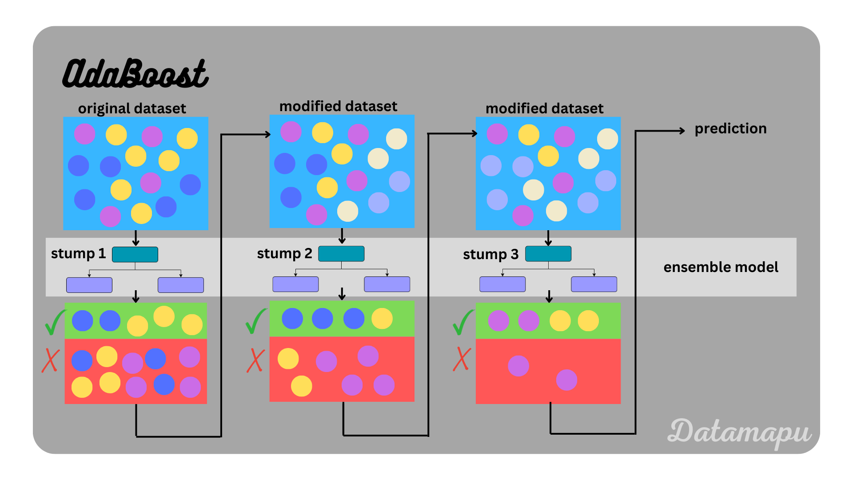
Principle of ADABOOST
Notes:
The principle behind ada boosting algorithms is that we first build a model on the training dataset and then build a second model to rectify the errors present in the first model. This procedure is continued until and unless the errors are minimized and the dataset is predicted correctly.

Slide 3

APPLICATIONS OF ADABOOST
Notes:
AdaBoost is widely used in applications such as face detection, object recognition, and text classification. It is particularly effective when the data is noisy or when there are many irrelevant features. AdaBoost can also be used in other areas of machine learning, such as regression and clustering.

Slide 4

USES OF ADABOOST
Notes:
AdaBoost makes predictions by calculating the weighted average of weak classifiers, where the weights are based on their performance and updated using a learning rate. The weak models are trained sequentially using weighted data samples that have been classified incorrectly.

Slide 5
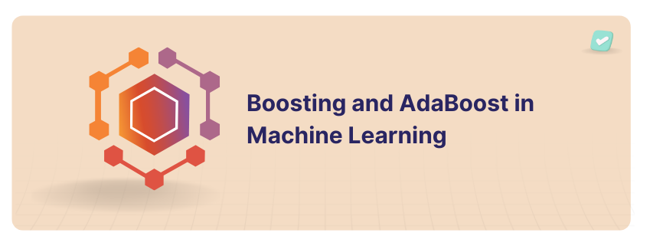
CONCLUSION OF ADABOOST
Notes:
AdaBoost is a powerful ensemble method that can improve the accuracy of a machine learning model. It works well on noisy data and is particularly effective for binary classification problems. Several variants of AdaBoost have been developed, including Adaptive Boosting and Gradient Boosting.

Slide 6

ADVANTAGES AND DISADVANTAGES OF ADABOOST
Notes:
Advantages: The flexible AdaBoost can also be used for accuracy improvement of weak classifiers and cases in image/text classification.
Disadvantages: Sensitive to noisy data and outliers that are not properly preprocessed. Can be computationally expensive, especially with large datasets.

